Slide 1
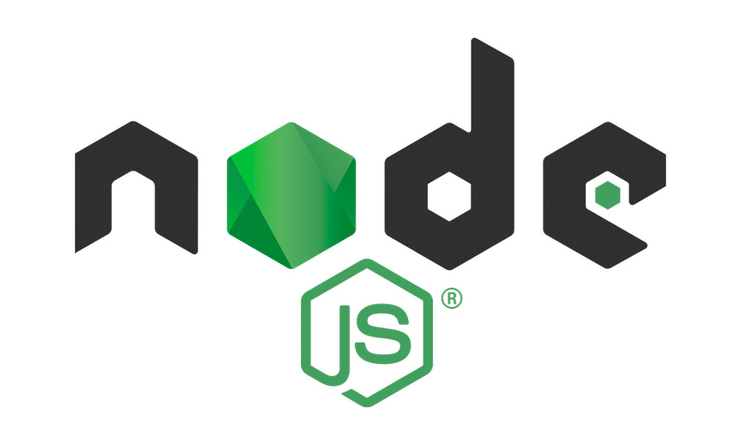
NPM & PACKAGES
Third-party packages and modules are prewritten code packets used to reduce development time by bootstrapping the features readily available in the package or module to write code faster, boost developer experience, or ship code for the users.

Slide 2
Local Project
<Project Source Code>
Core Node Packages
(FS, HTTP, HTTPS, PATH etc)
Dependencies (3RD Party Packages)
express
Body-parse
nodemon
etc
These Packages are installed & managed via npm

